Slide 1
Entropy

Slide 2
Entropy - Social Media, Unfiltered
A new social media app with no likes, no editing, and no filters
Targeting users who don’t post on Instagram because they are too afraid of not fitting in

Slide 3
Key Points
How expensive is it to get one user on Entropy?
How do we get users to keep coming back?
How much money can we make per user?

Slide 4
User Acquisition vs User Retention
TikTok
App Store Page
Entropy
Click Through Rate (CTR)
Conversion Rate (CR)
Standard: 1-3%
Ours: .975%
Standard: 11-40%
Ours: 14%
Retention Rate (RR)
Standard: Unknown
Ours: 5%-20%
Notes:
Click Through Rate:
Standard:
https://jungletopp.com/tiktok-ads-vs-facebook-ads/
https://funnel.io/blog/a-complete-guide-to-tiktok-ads-for-digital-agencies
https://theinfiniteagency.com/insights/social/tapping-into-tiktok-as-a-branding-platform/
Ours:
16/1,300 = 1.2%
30/4,000 = .75%
Conversion Rate:
https://www.apptweak.com/en/aso-blog/average-app-conversion-rate-per-category-2019
https://splitmetrics.com/blog/good-app-store-conversion-rate/

Slide 5
User Acquisition - Costs
 | Click Through Rate | Conversion Rate | Overall Rate | Cost / Impression | Cost / Download
Current | .975% | 11% | .11% | $.01 | $5.33
Low | 1.5% | 30% | .45% | $.01 | $2.2
High | 3% | 50% | 1.5% | $.01 | $.67
Notes:
TikTok: $32 for 6 downloads
TikTok conversion rate: 15%
Tiktok marketing plan and explain this data is from two random promotional videos

Slide 6
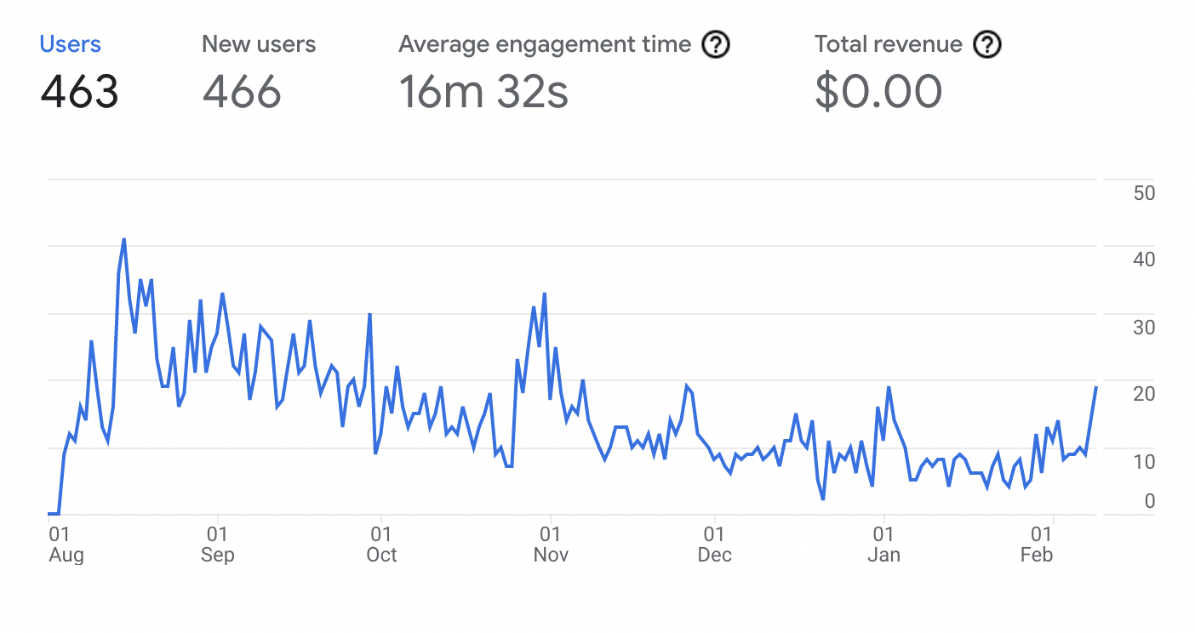
User Retention

Slide 7
User Retention
User retention is between 5%-20%
Notes:
Based on what we have seen over time.
We’ve noticed that when there are more people on the app at a given time, the retention rate is higher.

Slide 8
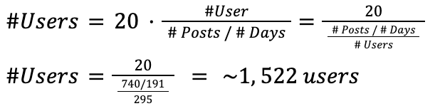
User Retention
To keep users coming back, they should see at least 1 interesting post every day, so they should see at least 20 new posts every day
To get 20 new posts per day, we need ~1,500 active users in the same cohort
The following is based on current numbers in the database

Slide 9
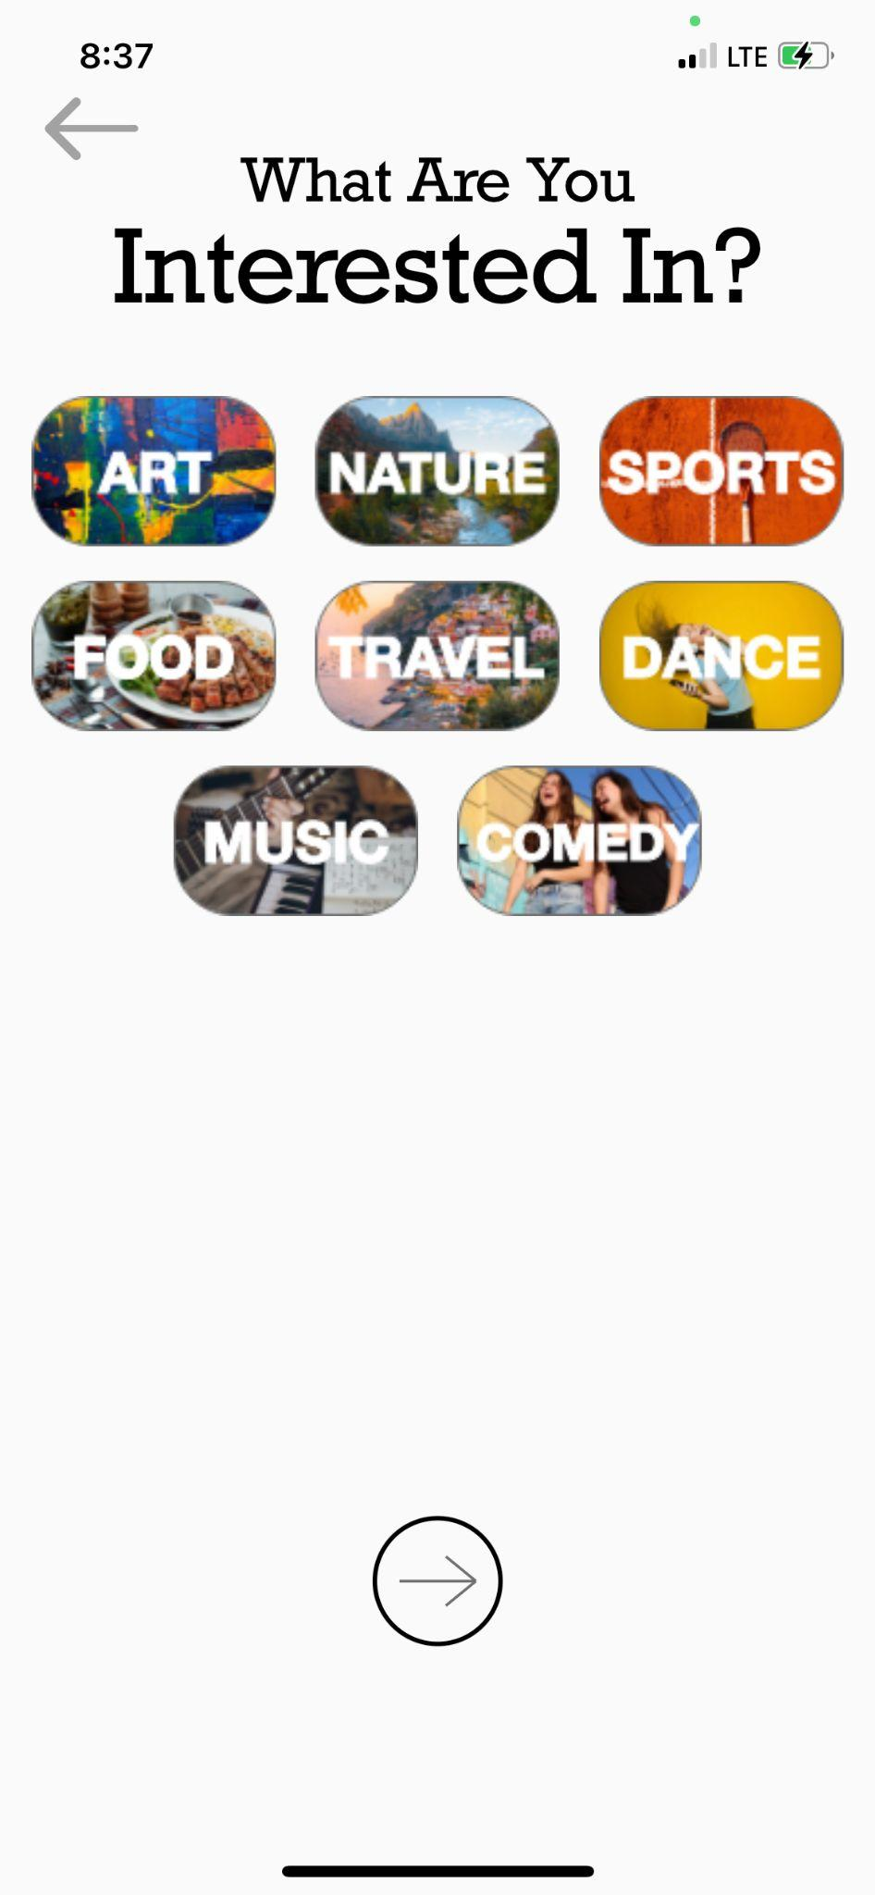
Revenue
Running targeted advertisement
Using our recommendation algorithm, run personalized advertisements
Allow advertisers to add a call-to-action in the caption
Can charge $5-$10 CPM
Selling user data
Allow users to control their recommendation algorithm
Can pick up on trends on what people are interested in
Notes:
CPM:
TikTok: $10
Instagram: $6.70
Facebook: $7.16
https://www.k6agency.com/instagram-ads-cost/

Slide 10
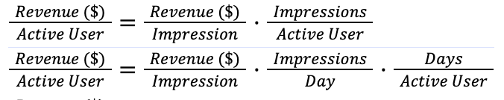
Revenue - Running Advertisements
Profits from advertising to active user:
 | Revenue / Impression | Impressions / Day | Days / Active User | Revenue / User
Low | $.005 | 1 | 60 | $.30
High | $.01 | 2 | 180 | $3.60

Slide 11
Profits
 | Cost / Active User | Revenue / Active User | Profit / Active User
Low | $2.2 | $.30 | -$1.90
High | $.67 | $3.60 | $2.40

Slide 12
What We’re Asking For
We are asking for $10,000
$560 - 4 weeks of experimental ad campaigns ($20/day)
$2,800 - 4 weeks of higher volume ad campaigns ($100/day)
$5,600 - 4 weeks of high volume ad campaigns ($200/day)
~$1,000 - miscellaneous expenses
Google cloud
Legal/accounting payments
Google Play / App Store payments
Notes:
For the $5,600:
Current: 1,050 (37/day)
Low: 2,545 (90/day)
High: 8,358 (298/day)

